Slide 1
Bank API's Full Stack Web Application
Overview of Backend Microservices and Frontend
B Harsha Kumar Reddy

Slide 2
Overview
Objective: Develop a full-stack web application for a banking system.
Features: User, Account, and Transaction management.
Technologies Used: Spring Boot (Backend), React.js (Frontend), MySQL (Database).

Slide 3
Backend Microservices
Microservices: UserService, AccountService, and TransactionService
Purpose: Decoupled architecture allowing independent deployment and scaling.
Technologies: Java, Spring Boot, RESTful APIs.

Slide 4
Detail Information About Microservices
UserService Details
Model Attributes: User ID, Username, Email, Address.
Endpoints:
GET /user: Retrieve all users.
GET /user/{id}: Retrieve specific user by ID.
POST /user/register: Register a new user.
POST /user/login: User login with credentials.
PUT /user/{id}: Update user profile by ID.
Base URL: http://localhost:8081/user

Slide 5
AccountService Details
Model Attributes: Account ID, Account Name, Account Type, Balance, Linked User ID, Secret Password.
Endpoints:
POST /accounts/register: Register a new bank account.
GET /accounts/user/{id}: Retrieve bank account information by user ID.
Base URL: http://localhost:8082/accounts
TransactionService Details
Model Attributes: Transaction ID, From Account ID, Transaction Type, To Account ID, Amount, User ID, Transaction Date.
Endpoints:
POST /transactions/register: Create a new transaction.
GET /transactions/user/{id}: Retrieve user transaction history.
Base URL: http://localhost:8082/transactions

Slide 6
Frontend Pages Overview
Home Page (Pre-Login): Basic homepage with login/register navigation.
Register Page: Form for new users to register.
Login Page: User authentication form.
Home Page (Post-Login): Basic Home page with profile, dashboard and logout buttons.
Dashboard: Shows linked accounts and transaction history.
Profile: User profile management page.

Slide 7
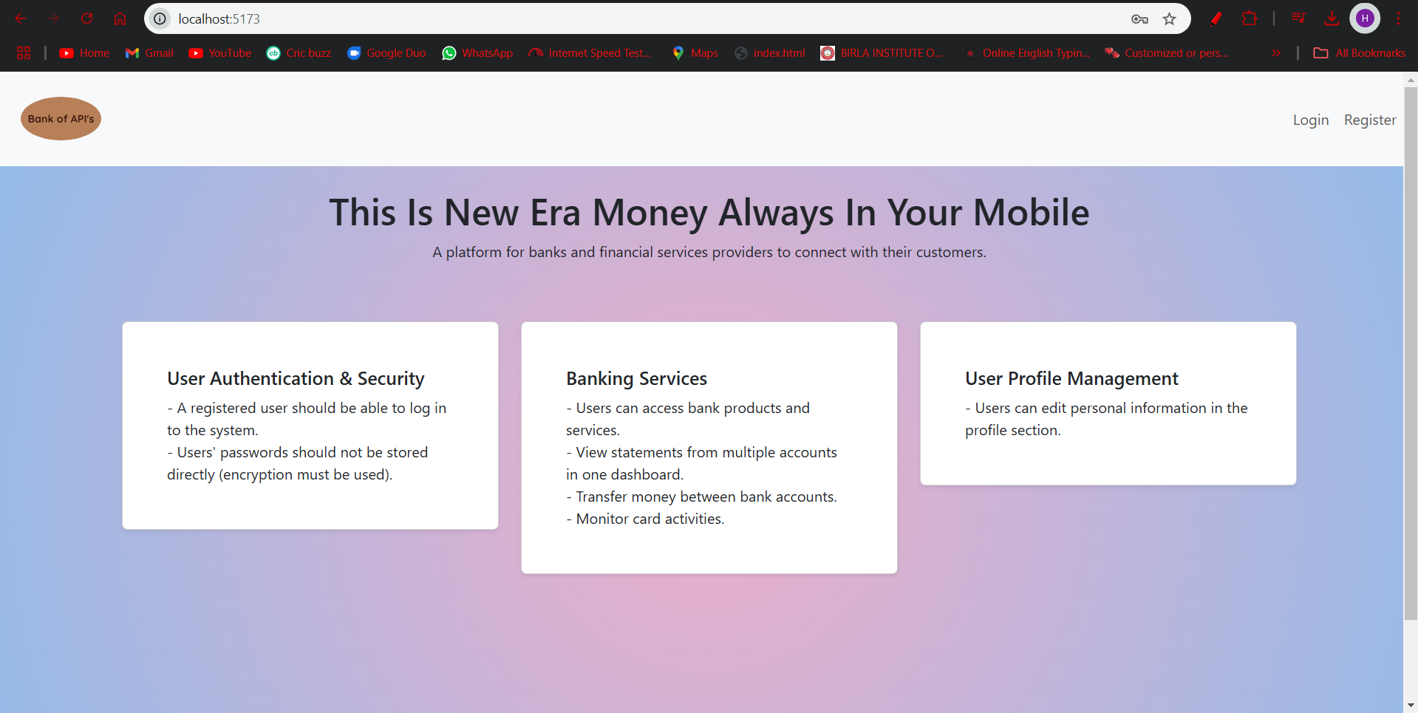
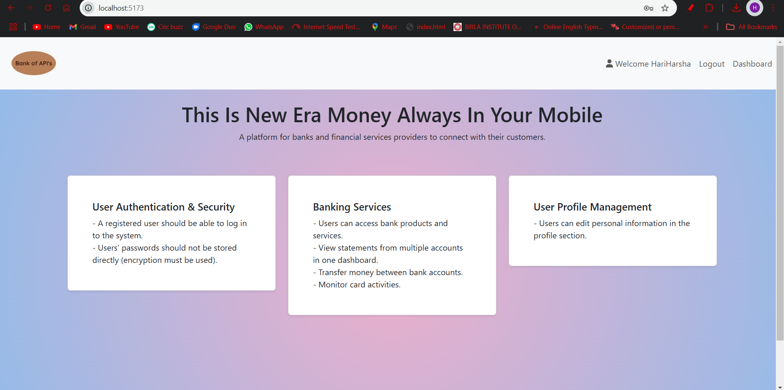
Home Page

Slide 8
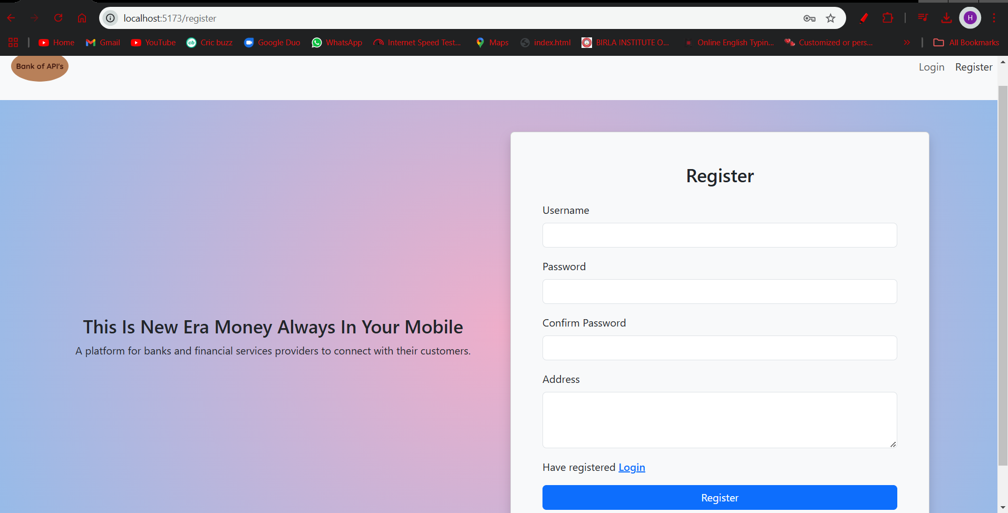
Register Page

Slide 9
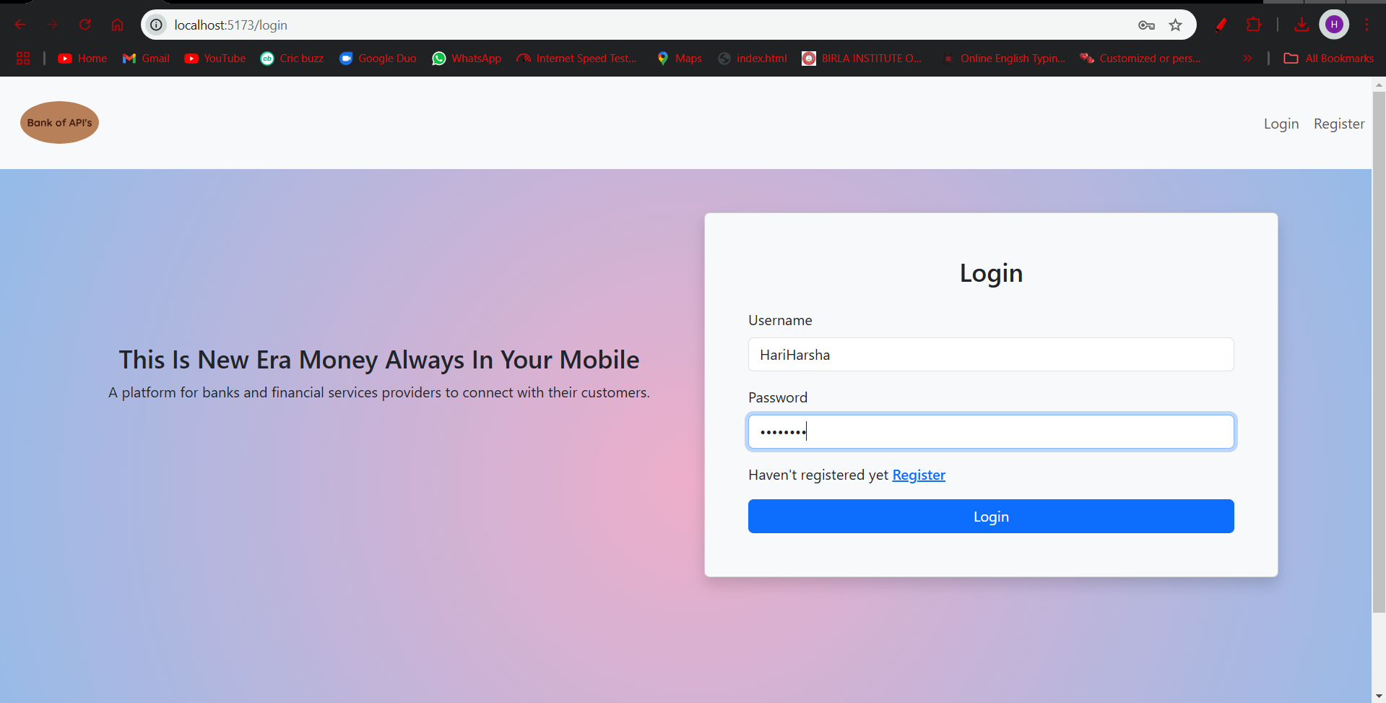
Login Page

Slide 10
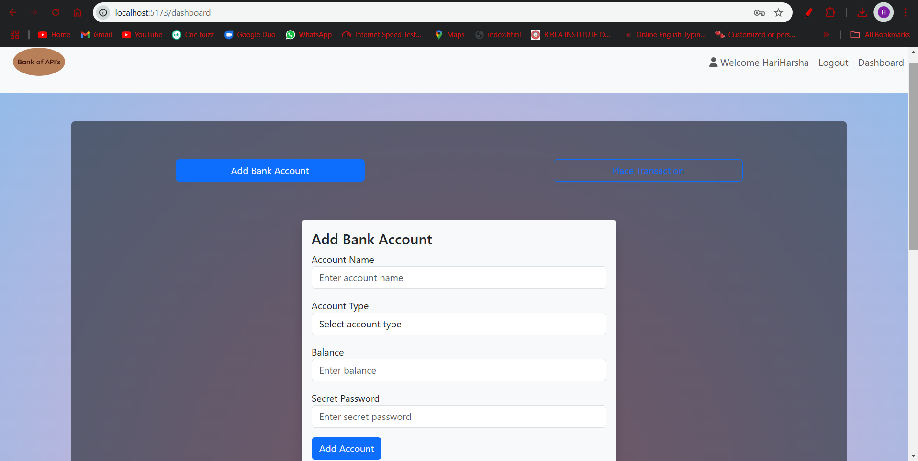
DashBoard Page

Slide 11
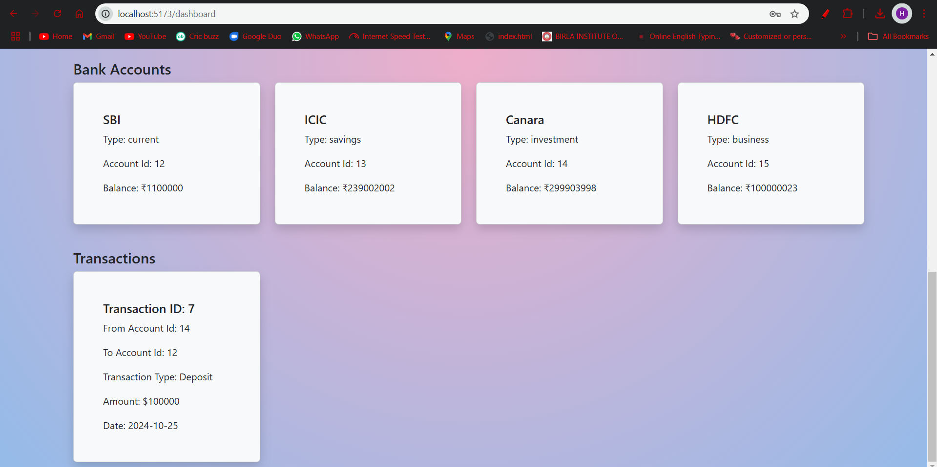

Slide 12
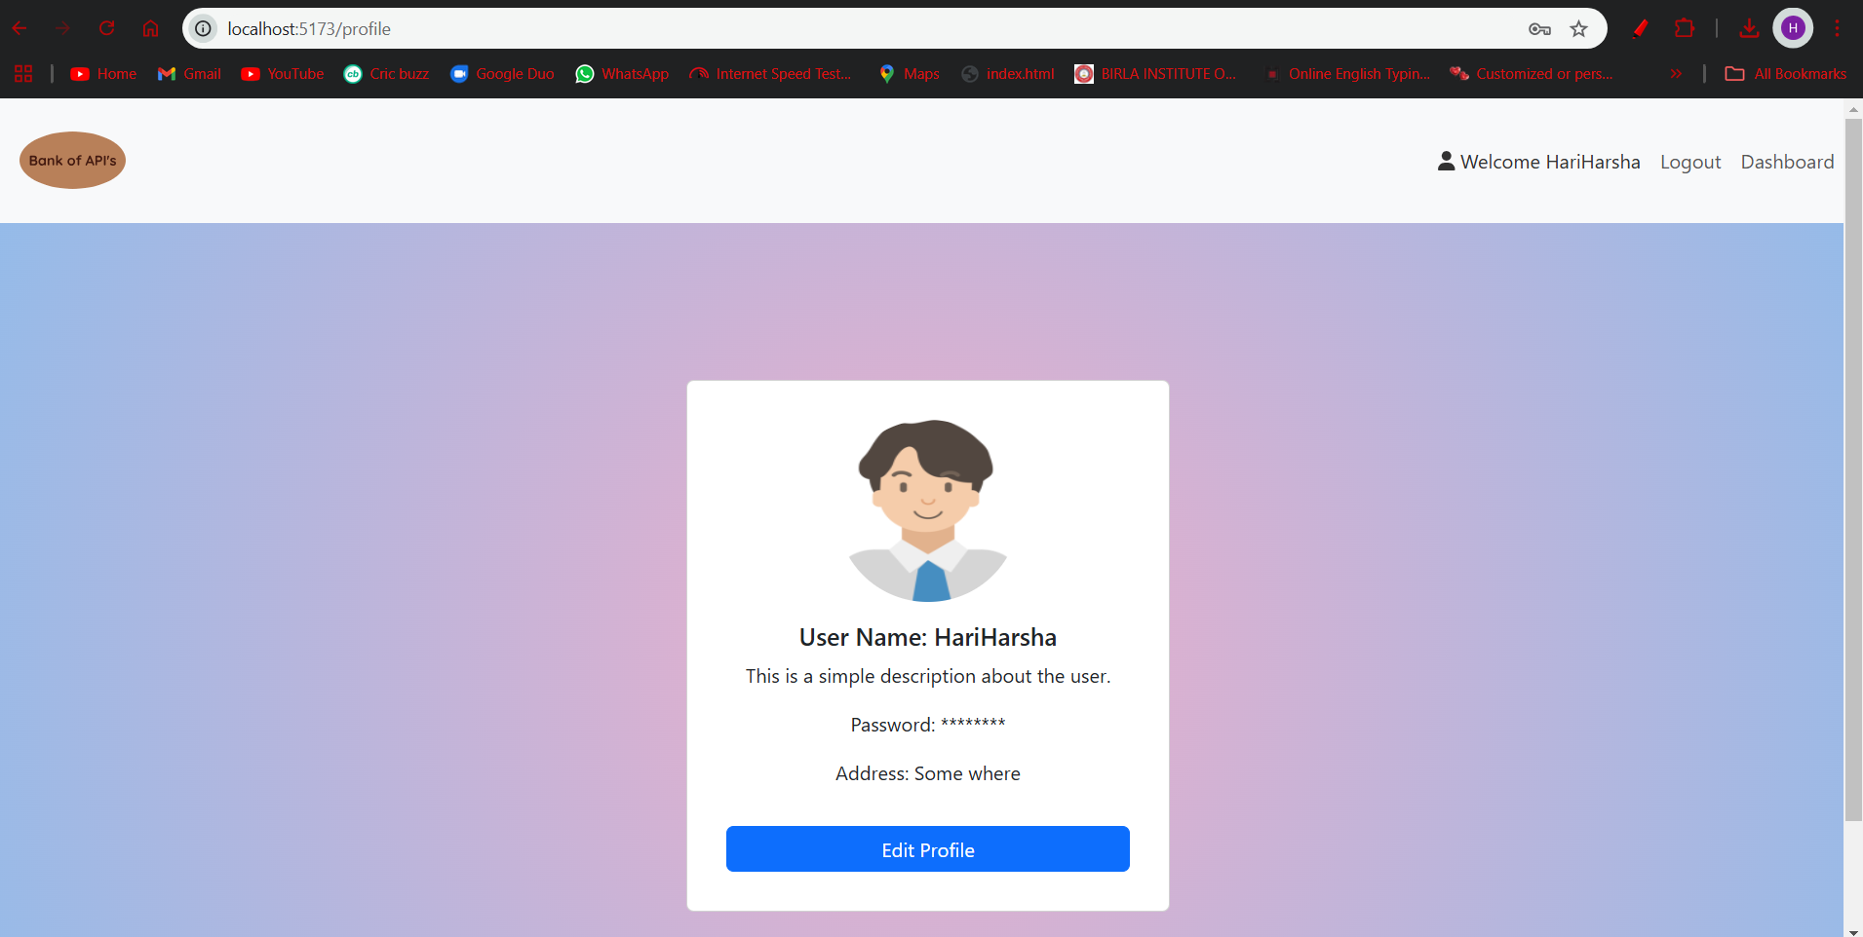
Profile Page

Slide 13
THANK YOU

